Slide 1
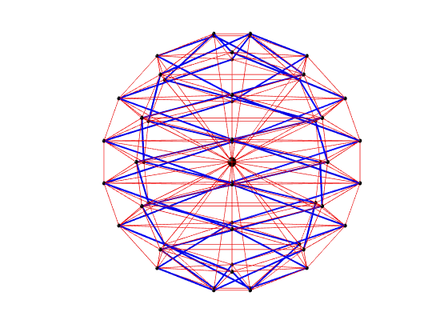
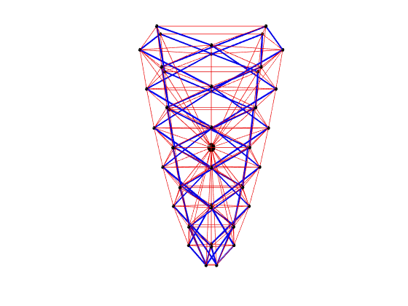
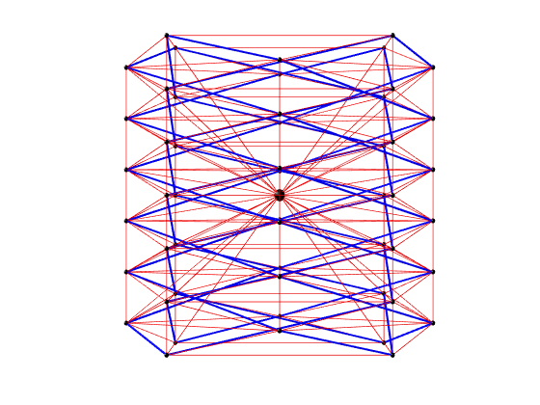
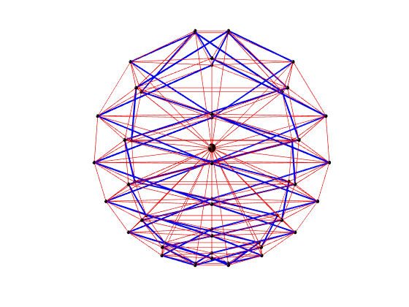
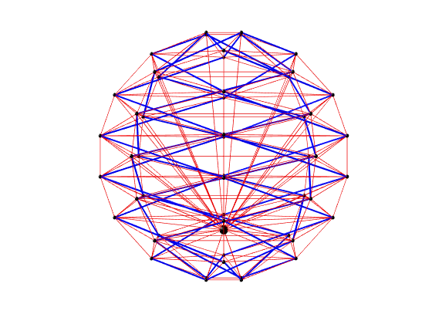
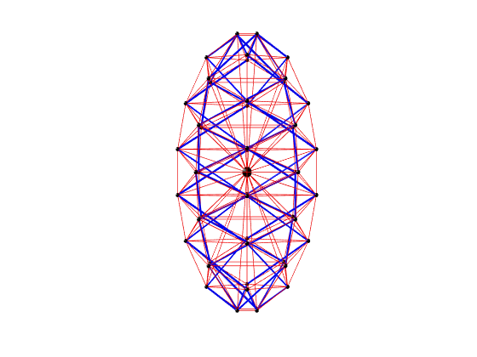
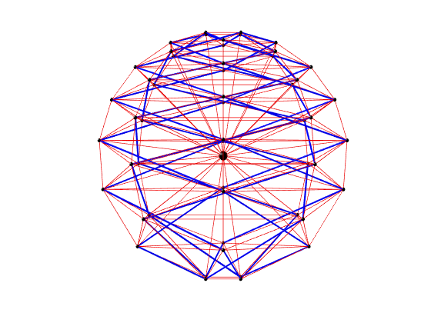
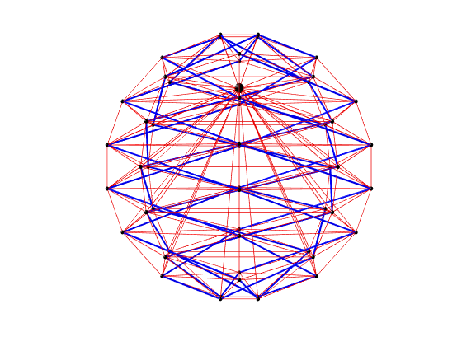
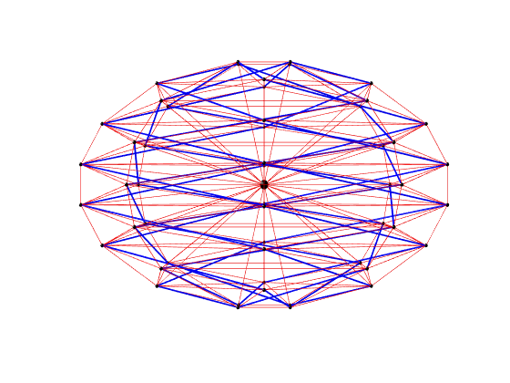

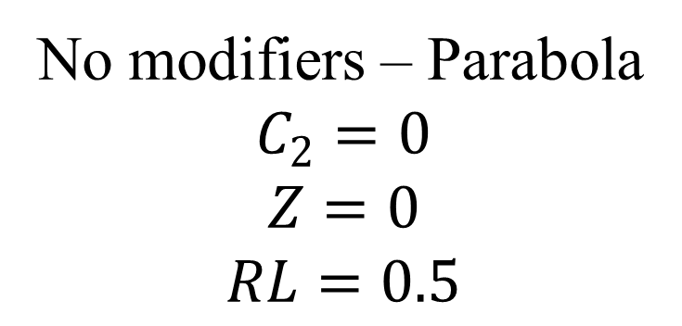


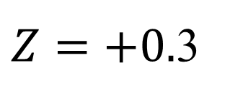
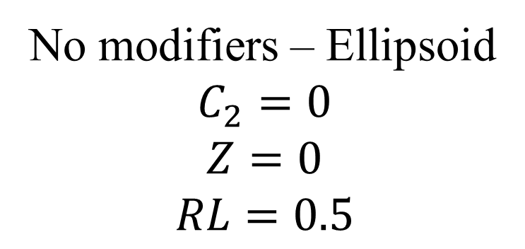

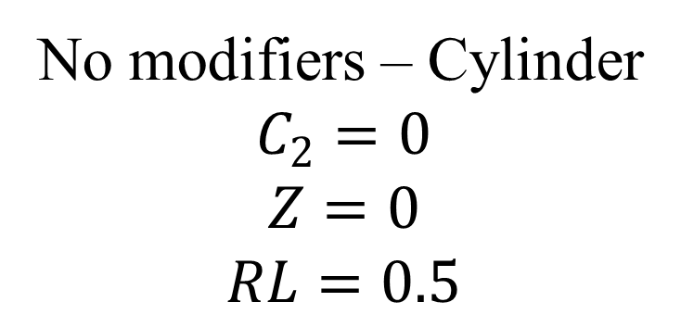
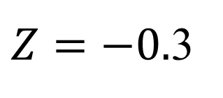
No modifiers – Ellipsoid
$$C_{2}=0$$
$$Z=0$$
$$RL=0.5$$
No modifiers – Parabola
$$C_{2}=0$$
$$Z=0$$
$$RL=0.5$$
No modifiers – Cylinder
$$C_{2}=0$$
$$Z=0$$
$$RL=0.5$$
$$C_{2}=−0.05$$
$Z=−0.$3
$$RL=0.25$$
$$C_{2}= +0.05$$
$Z=+0.$3
$$RL=0.25$$

